Slide 1
Crowd Activity Monitoring
N. Mandlik
K.L. Cserna

Slide 2
Hypothesis
Number of WiFi devices detected at a location is indicative of the crowd strength.
Probe requests are not sufficient to detect all devices in the vicinity.

Slide 3
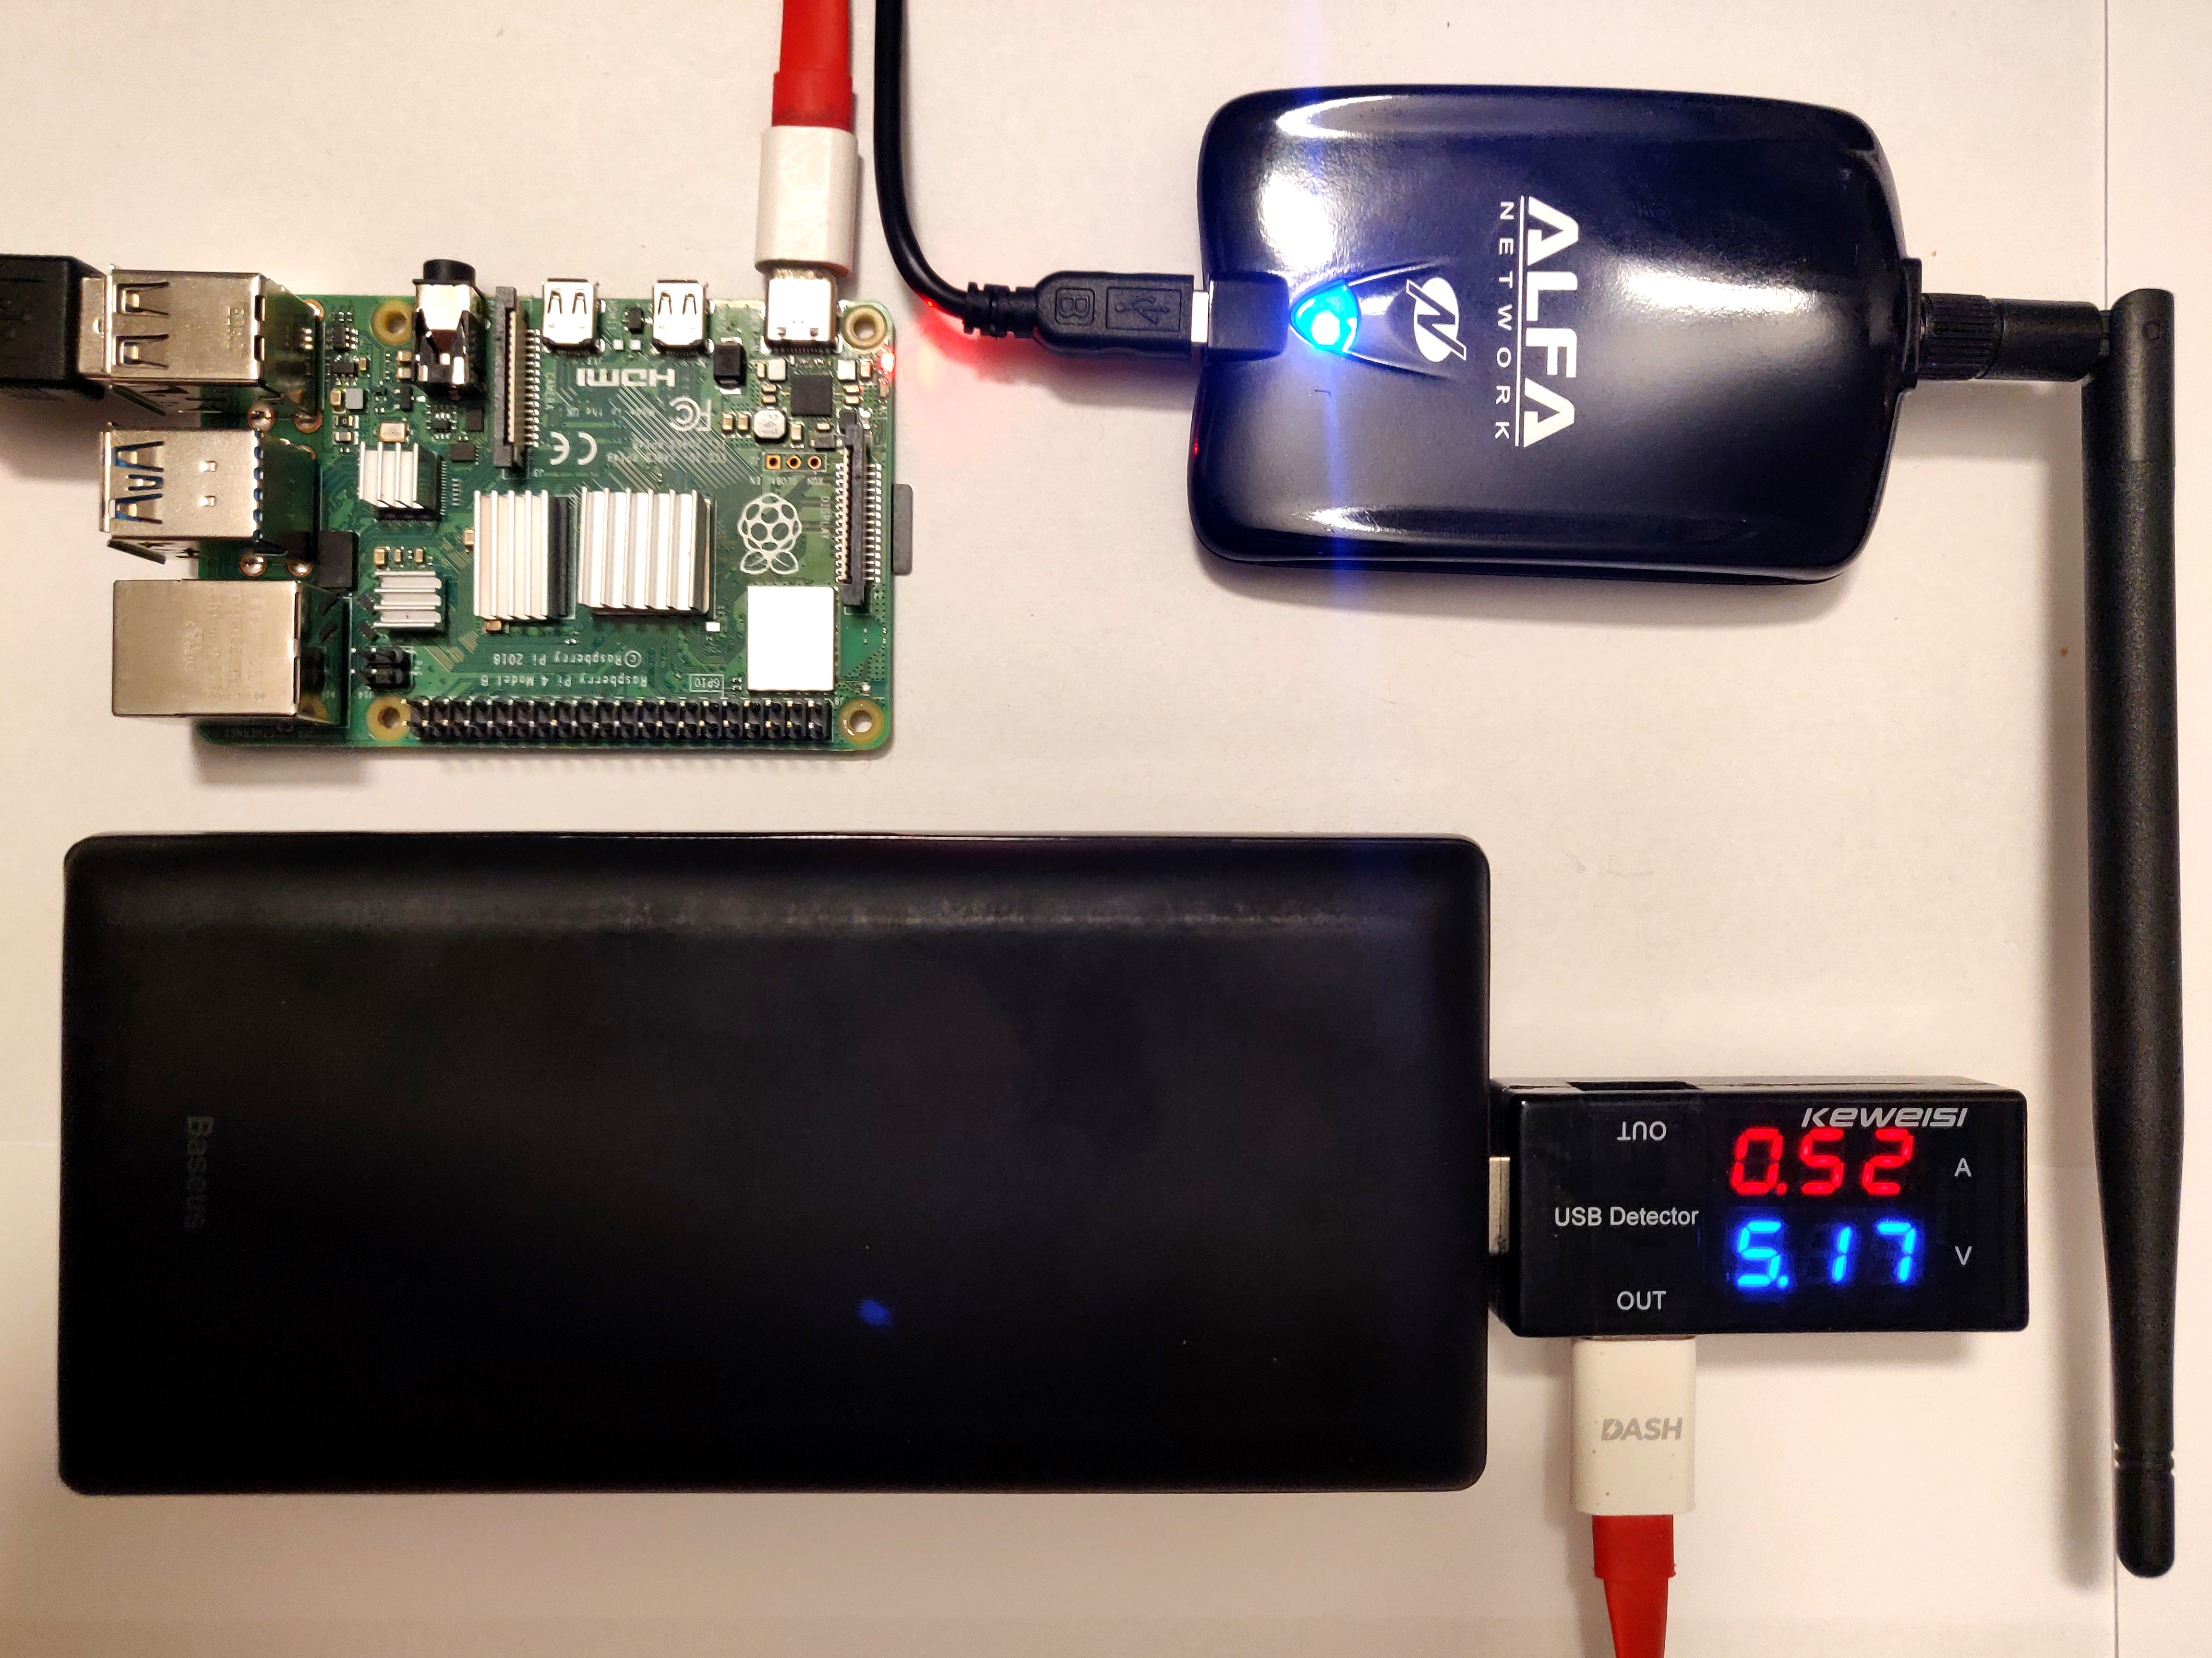
Method
Probe + Non-probe packets
Threshold on RSSI
Hardware
Pi 4
WiFi Adapter
Software
Ubuntu 20.10
Dumpcap
Python
5 Scenes

Slide 4
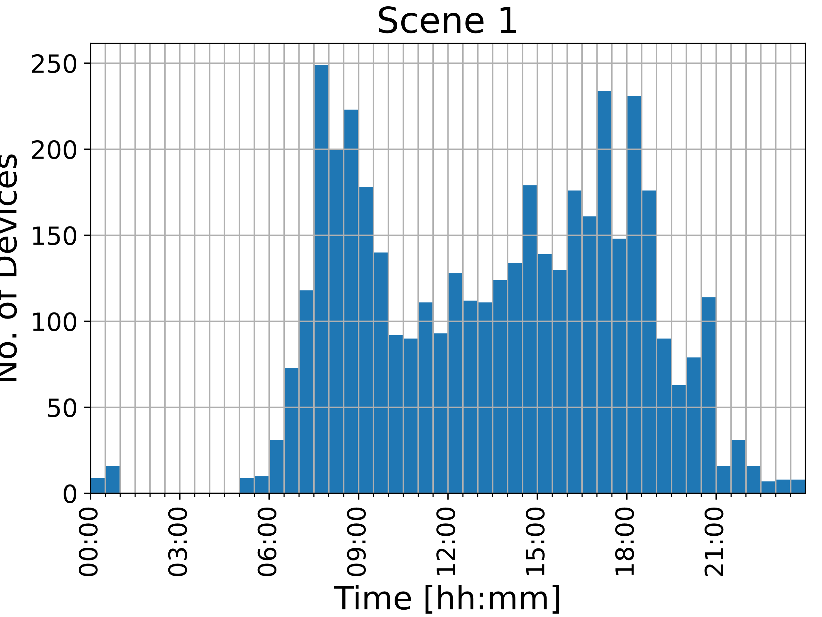
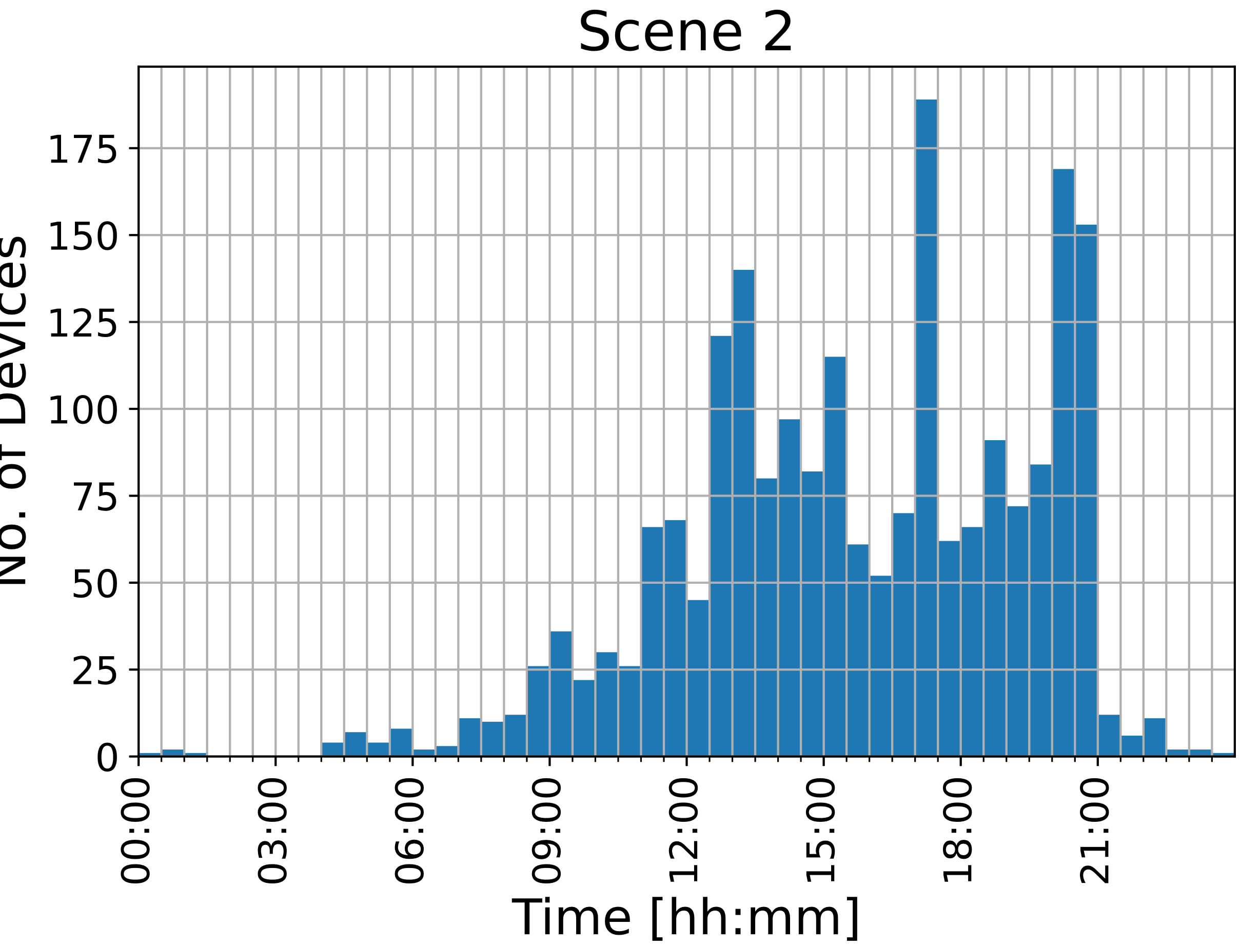
Scenes
24h measurement at each scene
Delft Station Bicycle Parking 1
Weekday
Weekend

Slide 5
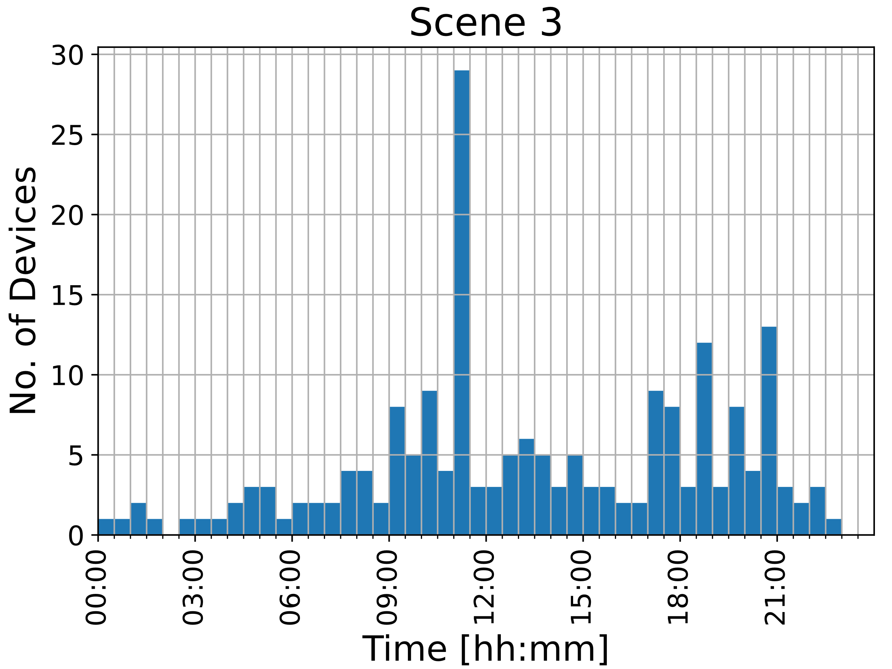
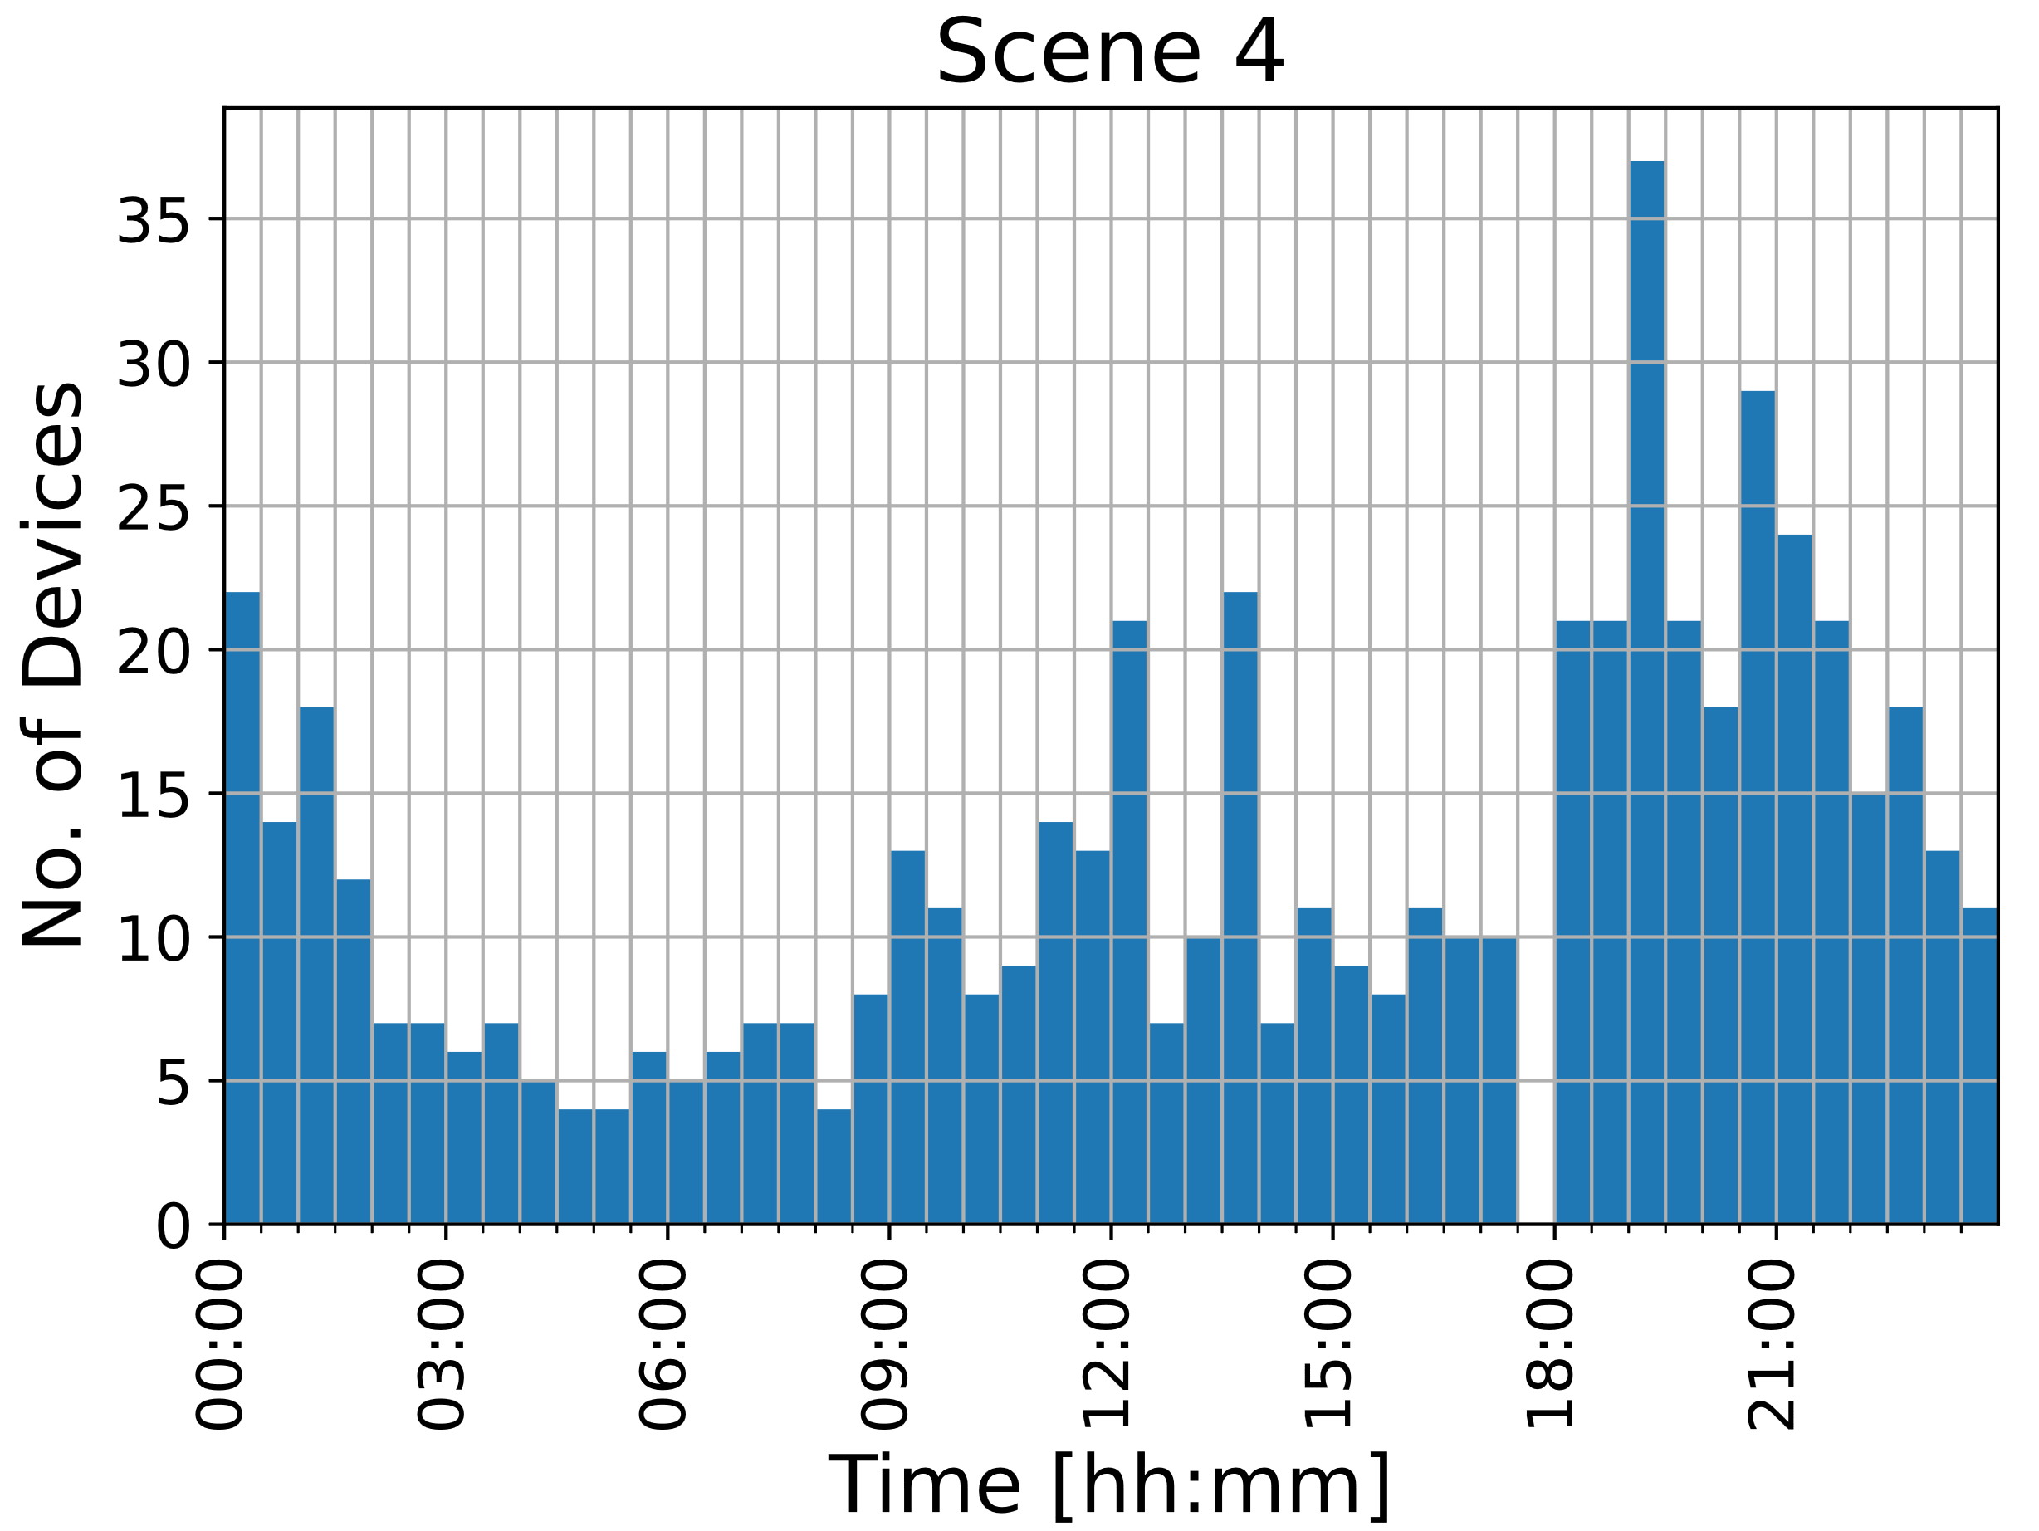
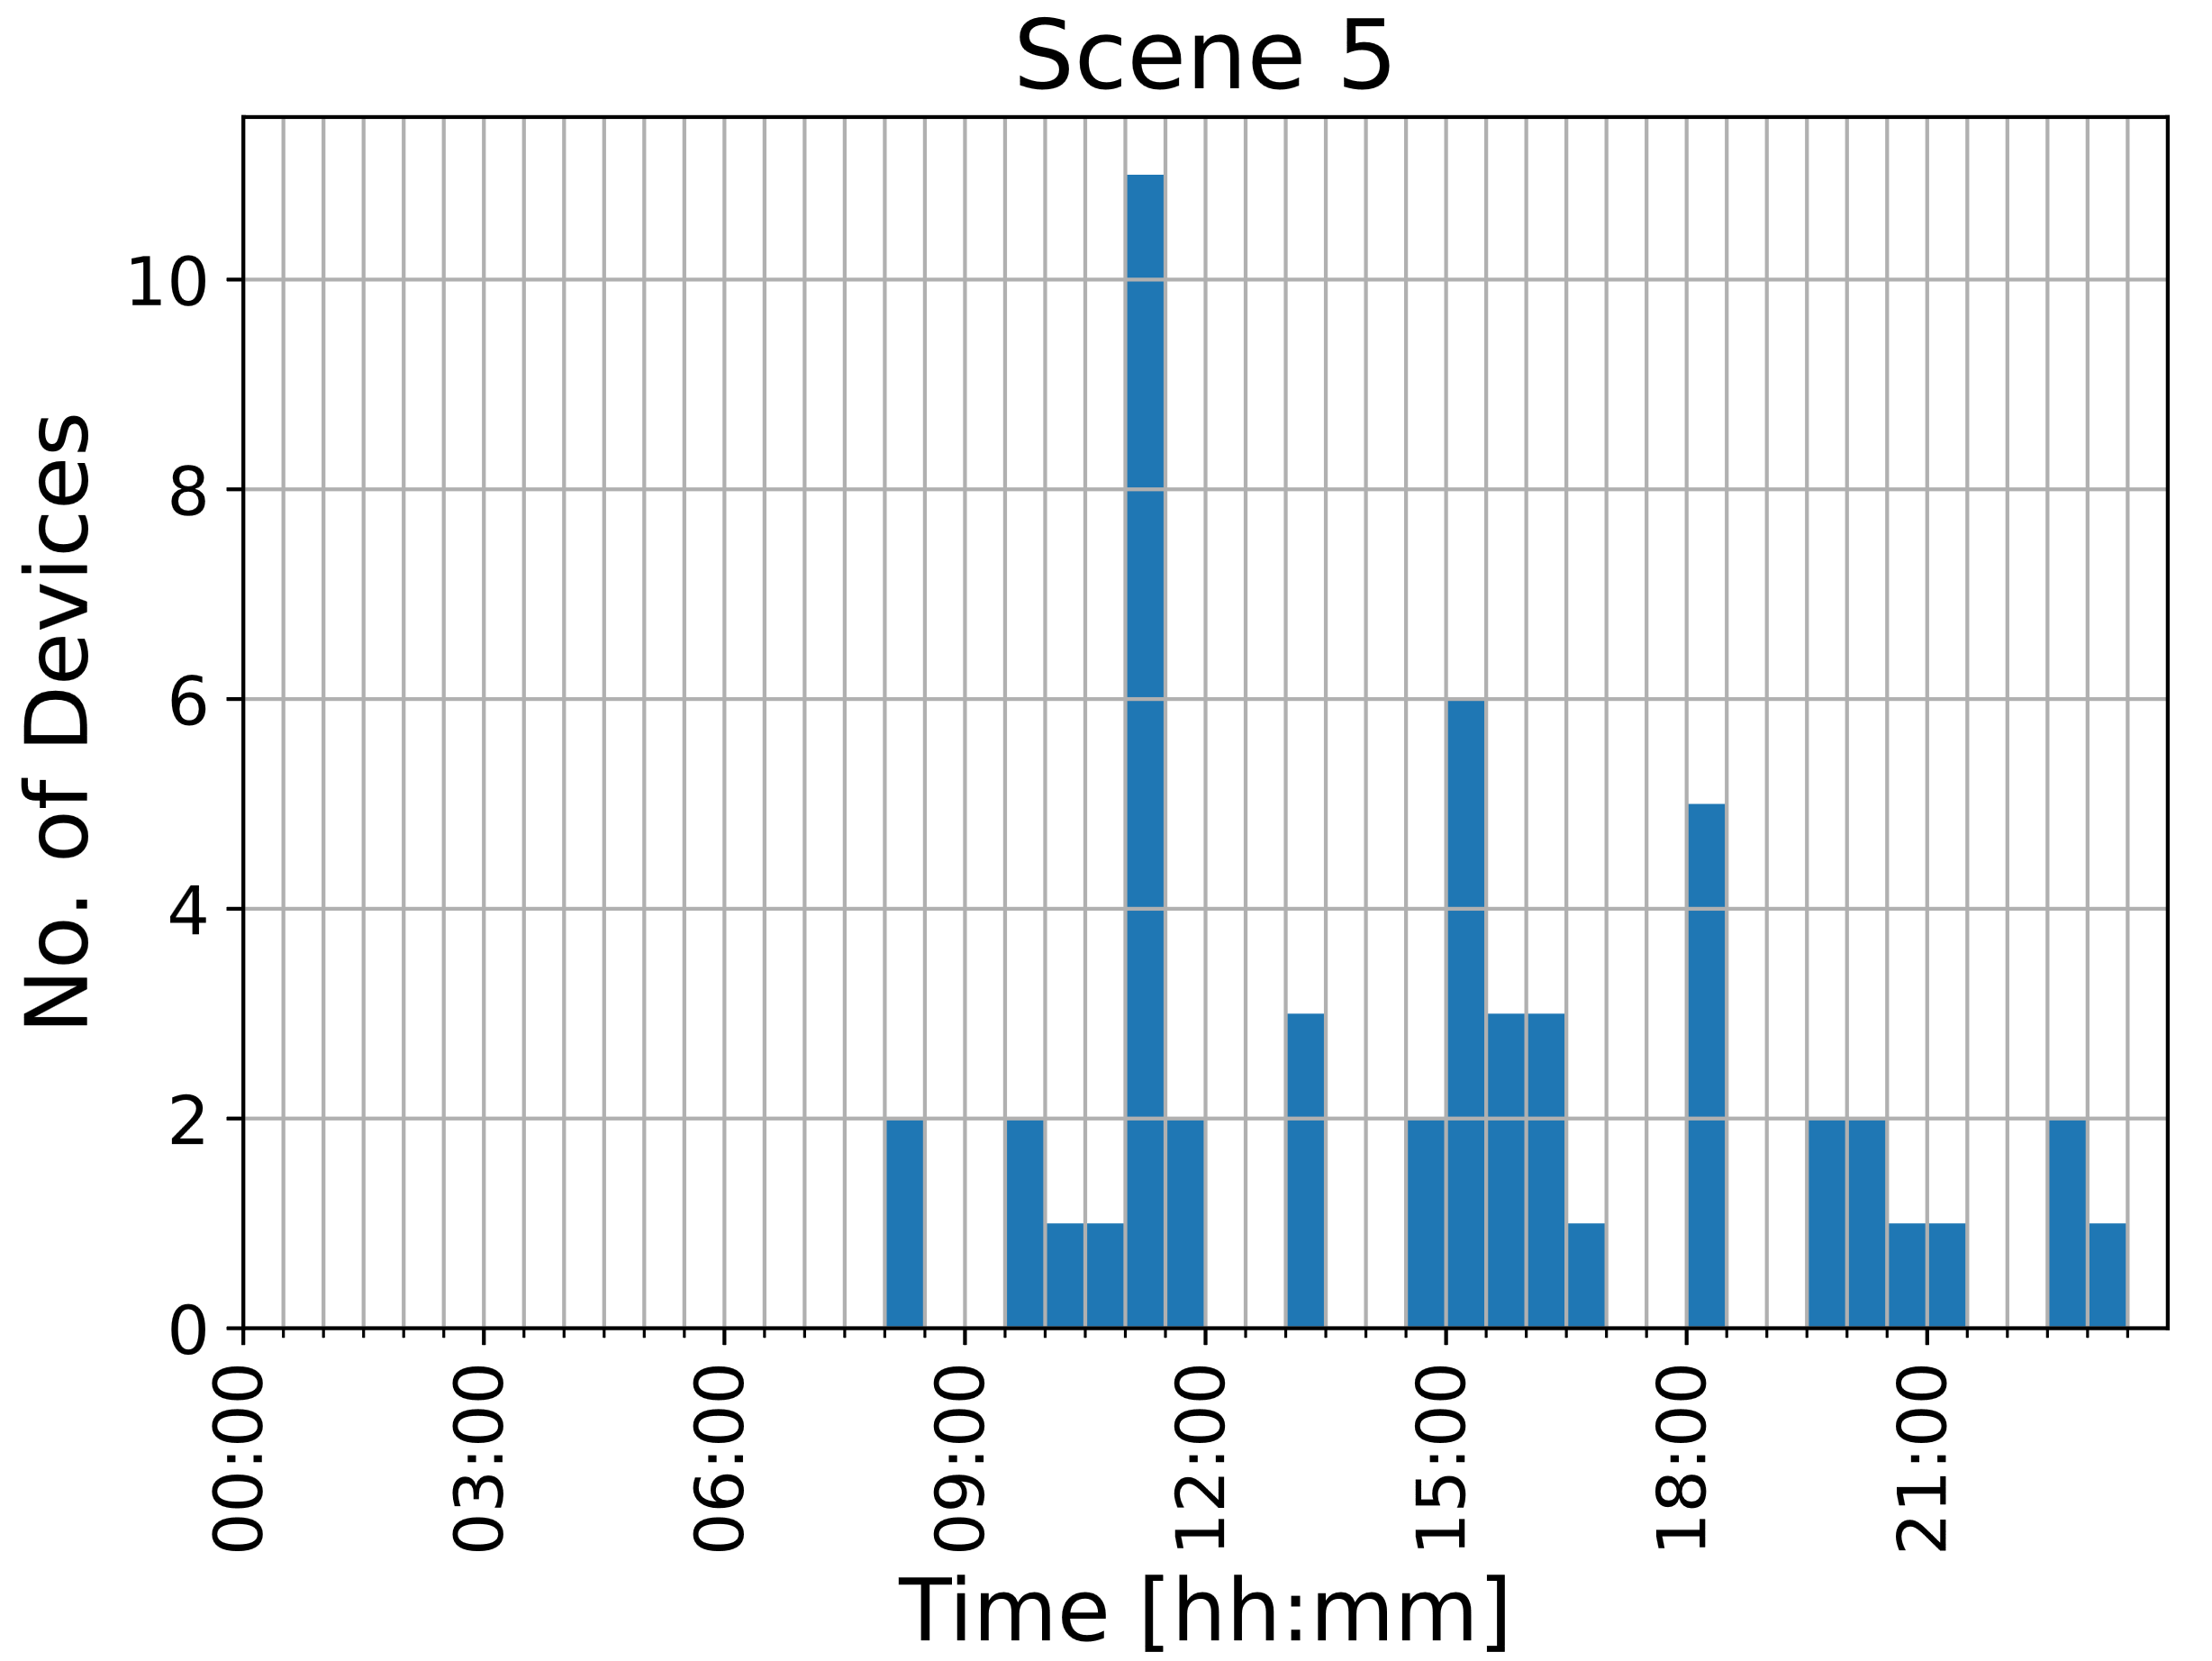
Scenes
Residential Building
Bicycle Parking
Corridor
Mailbox Room

Slide 6
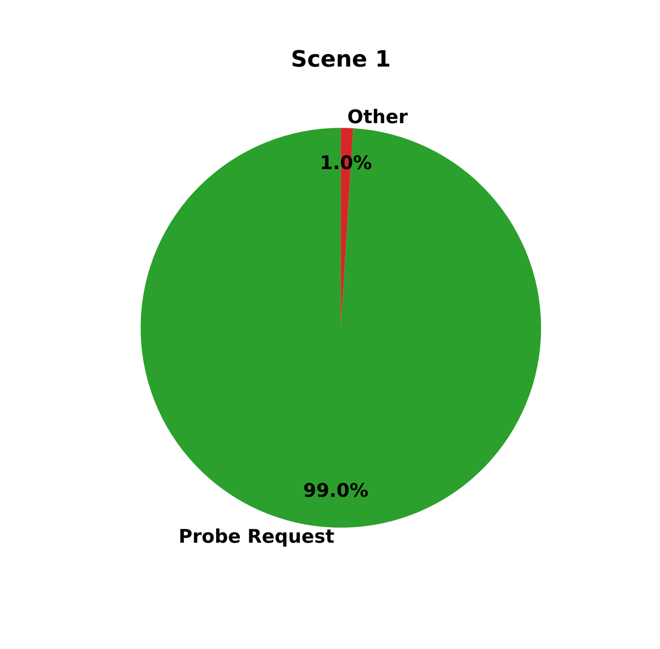
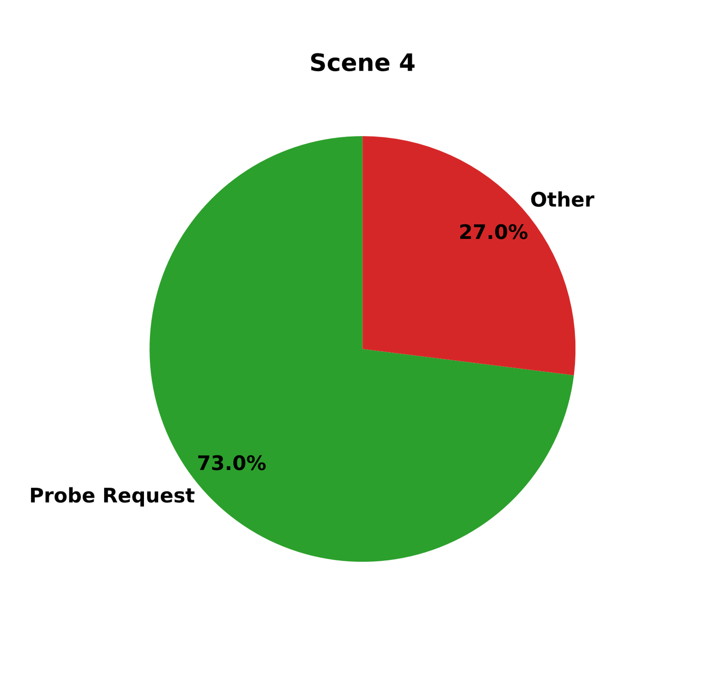
Means of detection
Delft Station Bicycle Parking 1
Residential Building Corridor

Slide 7
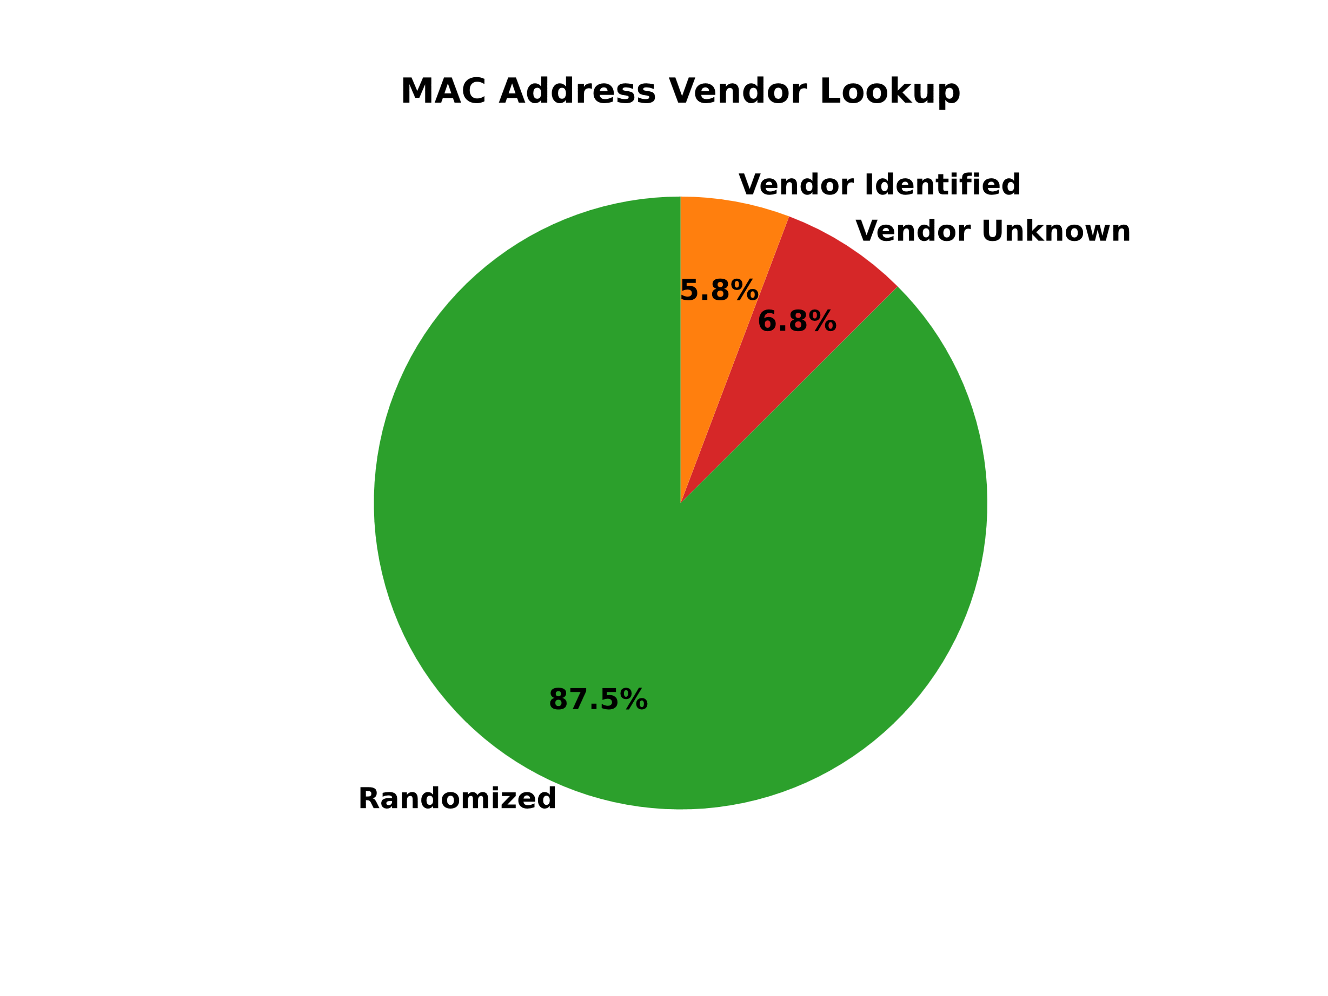
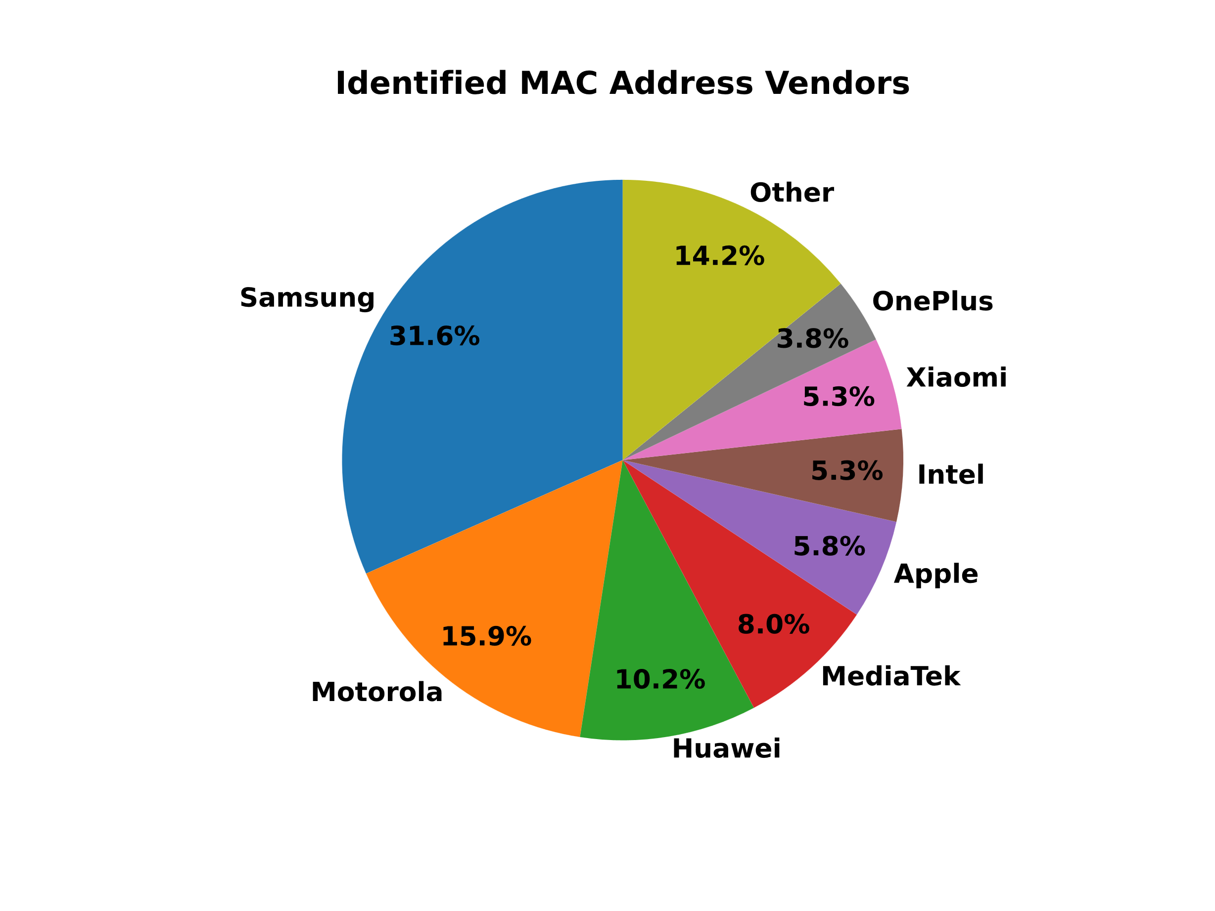
MAC address vendors

Slide 8
Conclusion
Analysis of WiFi packets can be used to monitor crowd patterns at a location.
At public places not having any open WiFi networks, probe requests are sufficient to detect the WiFi stations in that area
However, at locations where most stations are expected to be associated with an access point, other frame types need to be captured as well.

Slide 9

Questions

Slide 10
https://gitlab.ewi.tudelft.nl/et4394/2020-2021/wn-group-08

